Slide 1

CHIEF MINISTER INITIATIVE TEHSIL PINDIGHEB
KPI’S SPECIAL INITIATIVES
KPI’S INITIATIVE
Special KPI’S , SUTHRA Punjab, Beautification, Anti-Encroachment
Anti Beggary.

Slide 2
AGENDA POINTS
▶ KPIs
▶ Special Initiatives
▶ Suthra Punjab
▶ Beautification,
▶ Anti-Encroachment Activities
▶ Anti- Beggary,
▶ Pending NOCs / Cases
▶ Court Cases, Disciplinary Cases / Actions,
▶ HR details of all departments in your Tehsil.
▶ Issues & Suggestions

Slide 3
HR DETAILS
VACANCY POSITION AC OFFICE TEHSIL PINDIGHEB DISTRICT ATTOCK. 2024-25
Sr. No | Designation of post | BPS No. | No of post Sanctioned | No of post filled in | No of post vacant
1 | Assistant Commissioner | 17 | 01 | 01 | 0
 | Magistrate | 17 | 01 | 0 | 1
 | Tehsildar | 16 | 01 | 01 | 0
2 | Assistant | 16 | 01 | 01 | 0
3 | Naib Tehsildar | 14 | 02 | 02 | 0
4 | Stenographer | 15 | 01 | 0 | 01
5 | Senior Clerk | 14 | 01 | 01 | 0
6 | Junior Clerk | 11 | 08 | 05 | 03
7 | Driver | 5 | 02 | 02 | 0
8 | Naib Qasid | 1&2 & 4 | 10 | 08 | 02
9 | Class -IV | 1&2&4 | 04 | 02 | 02
Total |  |  | 32 | 23 | 09

Slide 4
HR DETAILS
VACANCY POSITION FIELD STAFF AC OFFICE TEHSIL PINDIGHEB DISTRICT ATTOCK. 2024-25
Sr. No | Designation of post | BPS No. | No of post Sanctioned | No of post filled in | No of post vacant
01 | Office Kanungo | 11 | 01 | 01 | 00
02 | Field Kanungo | 11 | 05 | 05 | 00
03 | Naib Office Kanungo | 09 | 02 | 02 | 00
 | Office Patwari | 09 | 01 | 01 | 00
04 | Patwari | 09 | 40 | 40 | 00
05 | Naib Qasid | 1&2 & 4 | 05 | 04 | 01
Total |  |  | 54 | 53 | 01

Slide 5
CHIEF MINISTER KPI’S & SPECIAL INITIATIVES SUTHRA PUNJAB

Slide 6
SUTHRA PUNJAB
Sr. No. | District | Tehsil | Total UCs | Villages | Est. Daily Waste (tons) | Contractor Firm/Company | Contract Amount for 4 Years (PKR Million) | Operations Start Date / Expected Date of Taking over of Operations
1 | Attock | Pindigheb | 11 | 80 | 106 | QC-ANBL-KC-JV (PVT-LTD) | 56.85 Millions 10% Mobilization Advance Transfer to contractor | 09-01-2025
2
3
4
5

Slide 7


PROGRESS MADE SO FAR (OUTSOURCED TEHSIL)
Description | Required Quantity | Uploaded on Dashboard | %age Uploaded on Dashboard
HR | 229 | 209 | 91%
Machinery | 65 | 53 | 83%
Government of the Punjab

Slide 8
PROGRESS MADE SO FAR (OUTSOURCED TEHSIL)
Sr. No. | District | Tehsil | HR On Dashboard %age | Machinery On Dashboard %age | Containers Deployment %age | Drums Deployment %age | Zero Waste Activity
 |  |  |  |  |  |  | Total Sites Identified | Total Sites Cleared | % Age | Waste Collected (tons)
1 | ATTOCK | Pindigheb | 91% | 83% | 100% | 0% | 55 | 50 | 90% | 109( Tons)
2
3
4
5
Total
Government of the Punjab

Slide 9
PROGRESS MADE SO FAR (OUTSOURCED TEHSIL)
Sr. No. | District | Tehsil | Tracker Status on Vehicles %age | Vehicles Branding %age | Containers Branding %age | Vehicles on which Banners pasted | Uniform Distribution %age
1 | Attock | Pindigheb | 84% | 66% | 75% | 60% | 70%
2
3
4
5
Government of the Punjab

Slide 10
PROGRESS MADE SO FAR (OUTSOURCED TEHSIL)
Sr. No. | District | Tehsil | Dumping Site Availability | Control Room Established | Weigh Bridge | RFID | VTCS
1 | Attock | Pindigheb | Available | Established/but PITB Link is Pending | Available | Installed | Installed
2
3
4
5
Government of the Punjab

Slide 11
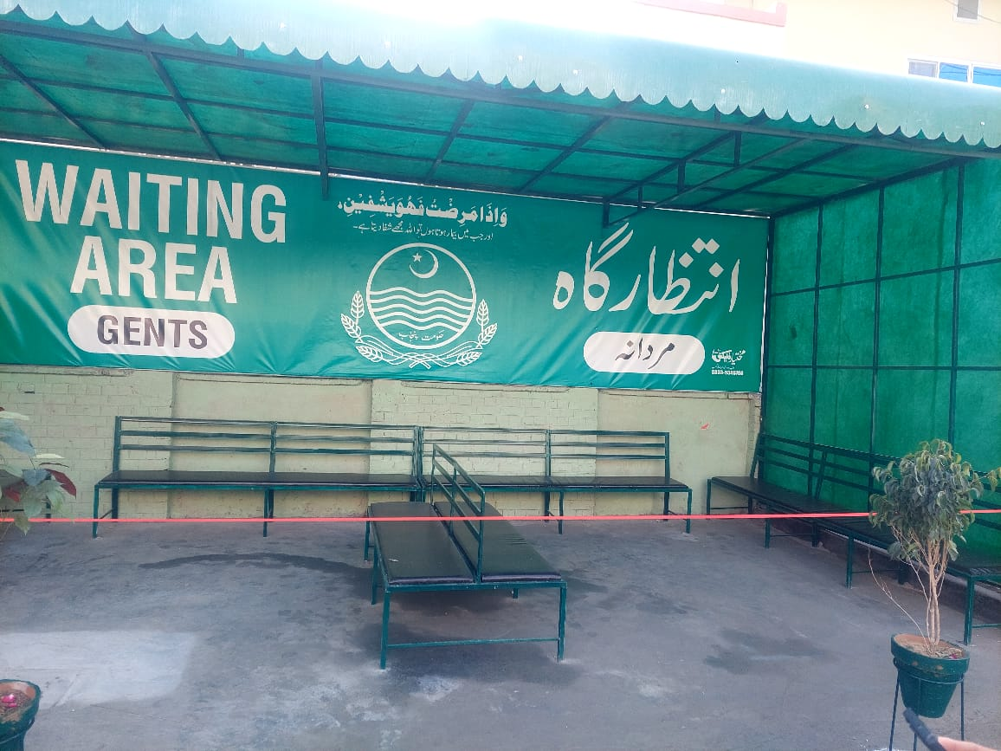
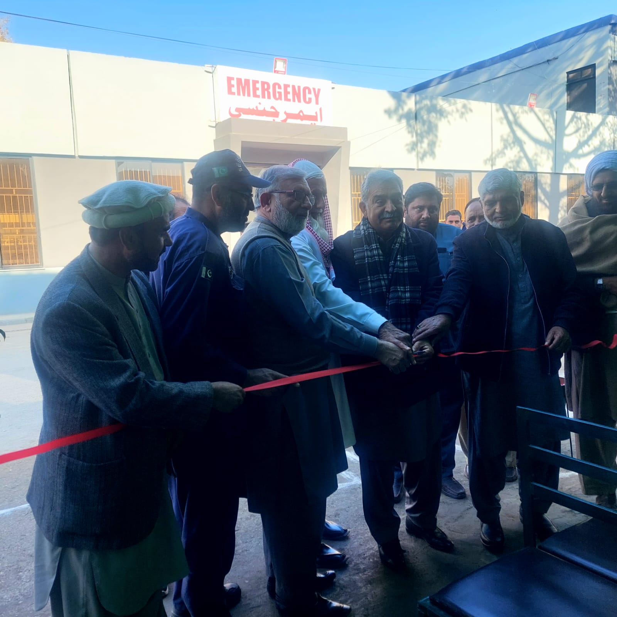
BEAUTIFICATION
Inauguration at THQ Hospital

Slide 12
ANTI ENCROACHMENT ACTIVITIES
18.01.2025 to Till DATE
NAME OF DISTRICT / TEHSIL | NO. OF BAZARS / ROADS IDENTIFIED | NO. OF HARD ENCROACHMENT REMOVED | NO. OF SOFT ENCROACHMENT REMOVED | NO. OF TEAMS DEPUTED | NO. OF MACHINERY DEPUTED | FIRS | FINE IMPOSED | NO. OF REHRI BAZARS ESTABLISHED
Pindigheb | 6 | 10 | 45 | 2 | 4 | Nil | 17000 | 01

Slide 13
ANTI ENCROACHMENT ACTIVITIES
18.01.2025 to till date
NAME OF DISTRICT / TEHSIL | TOTAL NO. OF TRUCKLOADS OF ENCROACHMENT REMOVED | TOTAL NO. OF ENCROACHMENT MATERIAL CONFISCATED/ REMOVED | REMOVAL OF CARTS PLACED AT ROAD SIDES AND PARKING SPACES | REMOVAL OF COUNTERS PLACED/FIXED AT ROAD SIDES AND PARKING SPACES | REMOVAL OF ILLEGAL PLATFORMS IN FRONT OF SHOPS/HOUSES
Pindigheb | 5 | 55 | 40 | 30 | 8

Slide 14
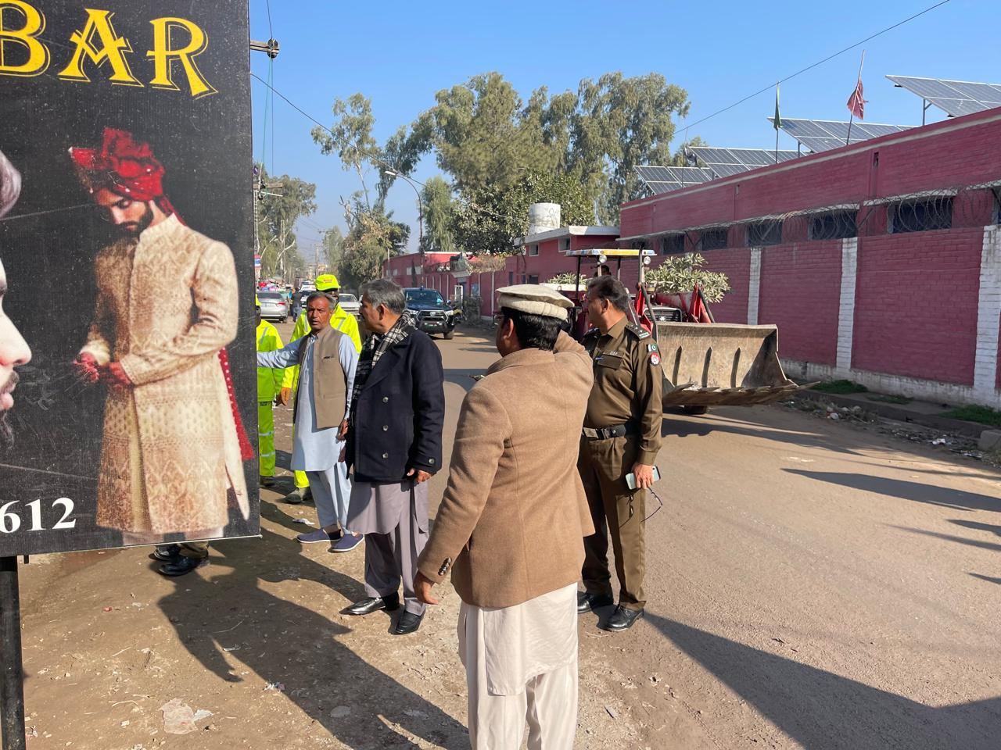
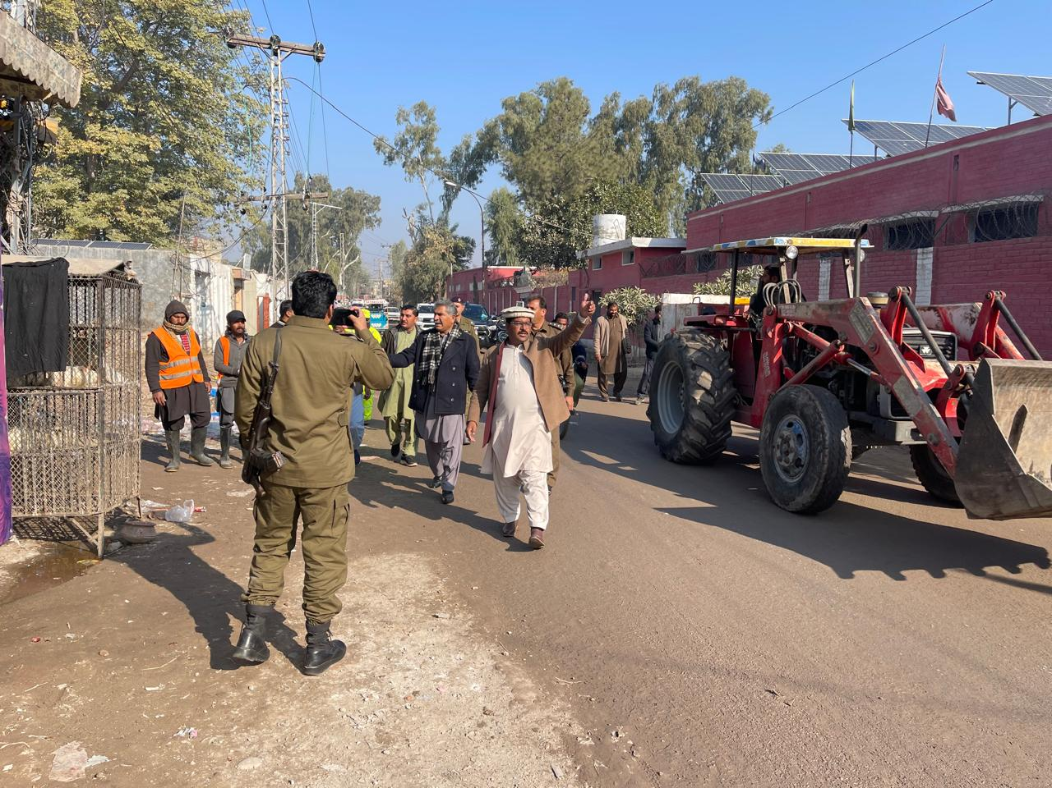
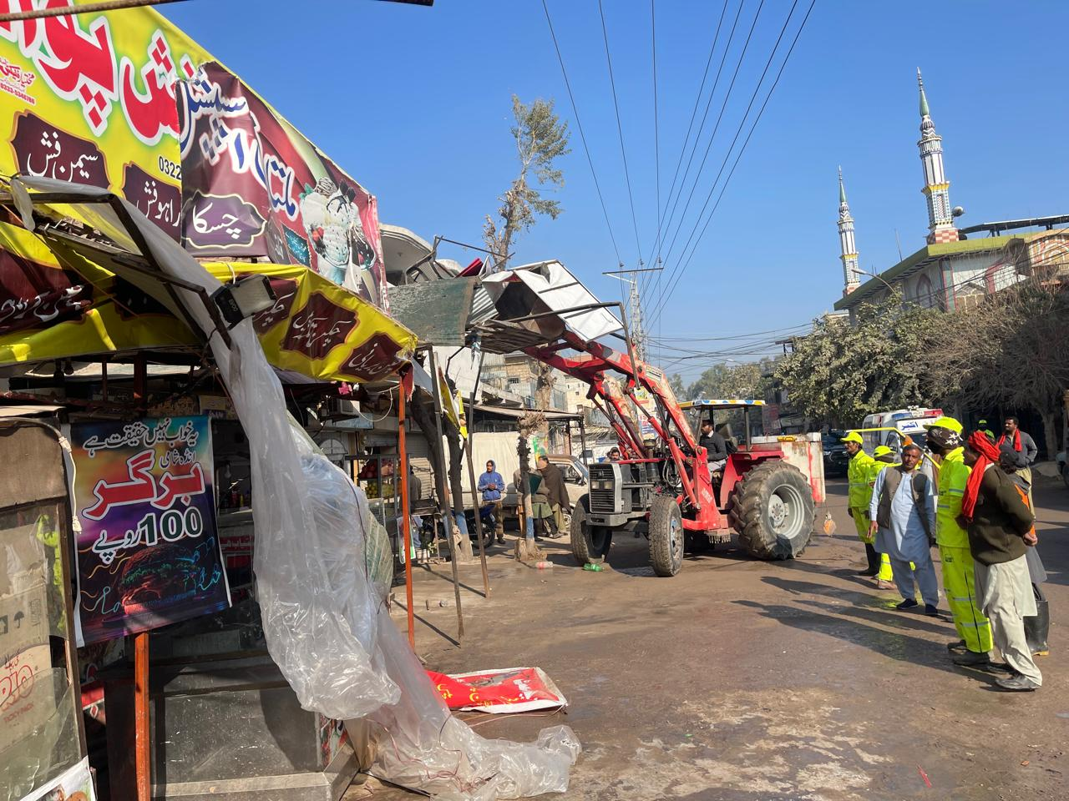
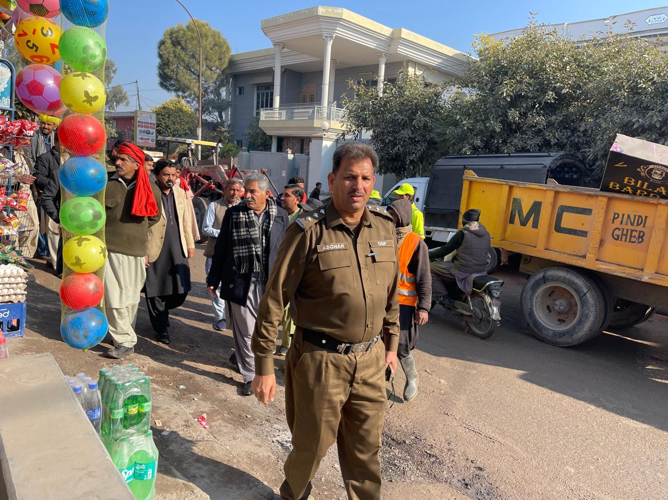
ANTI ENCROACMENT
V

Slide 15
ANTI BEGGARY
NIL
PENDING NOCS/ CASES
Pendency Zero
SUMMARY REGARDING DISCIPLINARY CASES
Pendency Zero

Slide 16
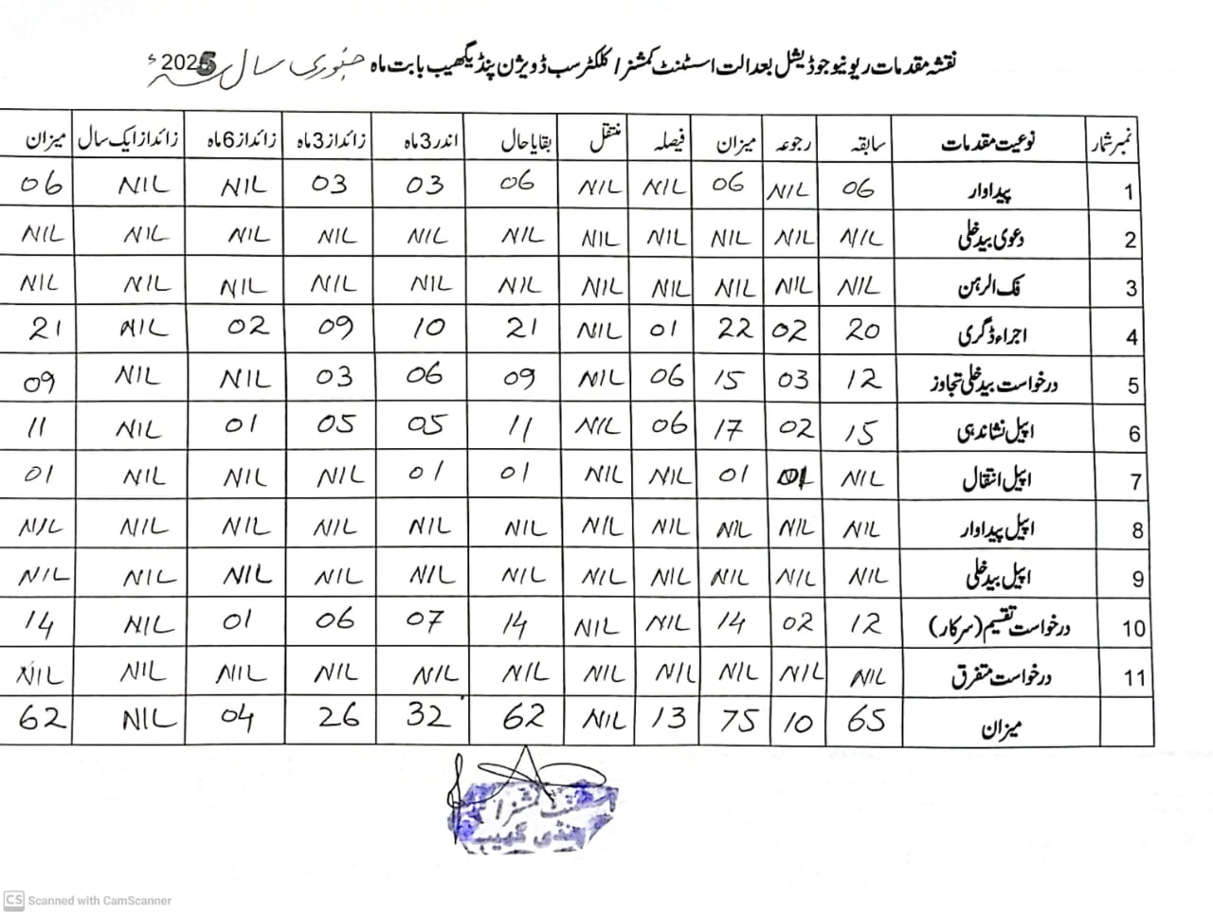
COURT OF ASSISTANT COMMISSIONER PINDIGHEB

Slide 17
PSER REGISTRATION
Sr. NO | Division | DISTRICT | TEHSIL | UC | PROJECTED POPLUATION (SENSES 2023) | UC-WISE PROPORTIONATE QUOTA | Registration Progress | BISP Beneficiaries | Remaining Target
1 | RAWALPINDI | ATTOCK | PINDIGHEB | M.C PINDIGHEB | 56009 | 1316 | 900 | 104 | 480
2 | RAWALPINDI | ATTOCK | PINDIGHEB | UC-46 MIANWALA | 25686 | 603 | 1265 | 166 | 108
3 | RAWALPINDI | ATTOCK | PINDIGHEB | UC-47 DANDI | 26812 | 630 | 977 | 149 | 400
4 | RAWALPINDI | ATTOCK | PINDIGHEB | UC-48 IKHLAS | 24420 | 574 | 757 | 116 | 500
5 | RAWALPINDI | ATTOCK | PINDIGHEB | UC-49 AHMEDAL | 11253 | 264 | 427 | 50 | 152
6 | RAWALPINDI | ATTOCK | PINDIGHEB | UC-50 KAMRYIAL | 18410 | 433 | 374 | 62 | 121
7 | RAWALPINDI | ATTOCK | PINDIGHEB | UC-51 KOHAR | 26283 | 618 | 947 | 154 | 443
8 | RAWALPINDI | ATTOCK | PINDIGHEB | UC-52 GHREEBWAL | 26558 | 624 | 416 | 48 | 256
9 | RAWALPINDI | ATTOCK | PINDIGHEB | UC-53 CHAKI | 19905 | 468 | 455 | 89 | 102
10 | RAWALPINDI | ATTOCK | PINDIGHEB | UC-54 MERA SHARIF | 45031 | 1058 | 957 | 154 | 255
11 | RAWALPINDI | ATTOCK | PINDIGHEB | UC-55 MALHAWALI | 23050 | 542 | 990 | 167 | 261
12 | RAWALPINDI | ATTOCK | PINDIGHEB | UC-56 KHARPA | 23984 | 563 | 445 | 92 | 210

Slide 18
Price Control
Month of December | FINE RS/ 331,500
Month of January | FINE RS/ 180,500

Slide 19
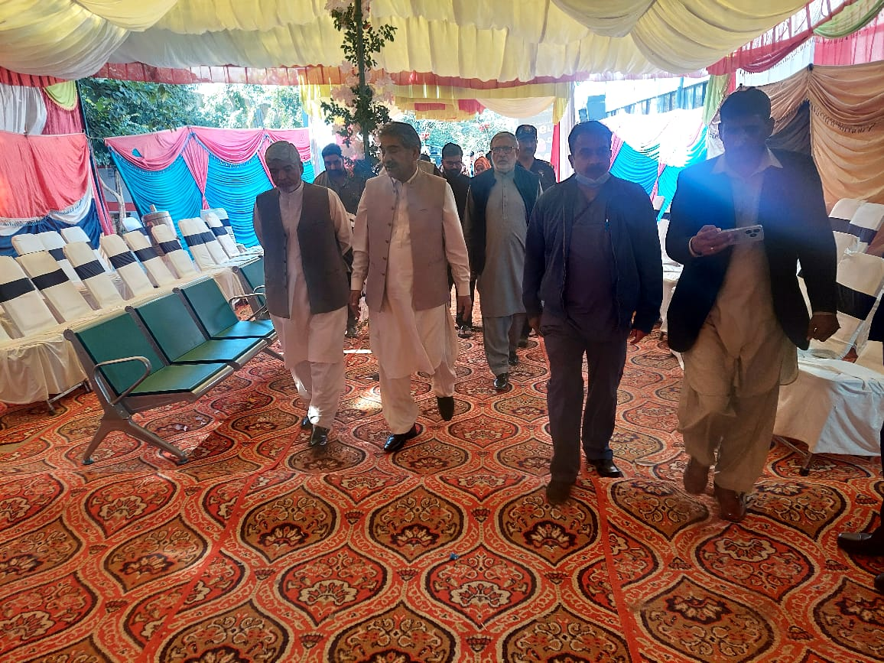
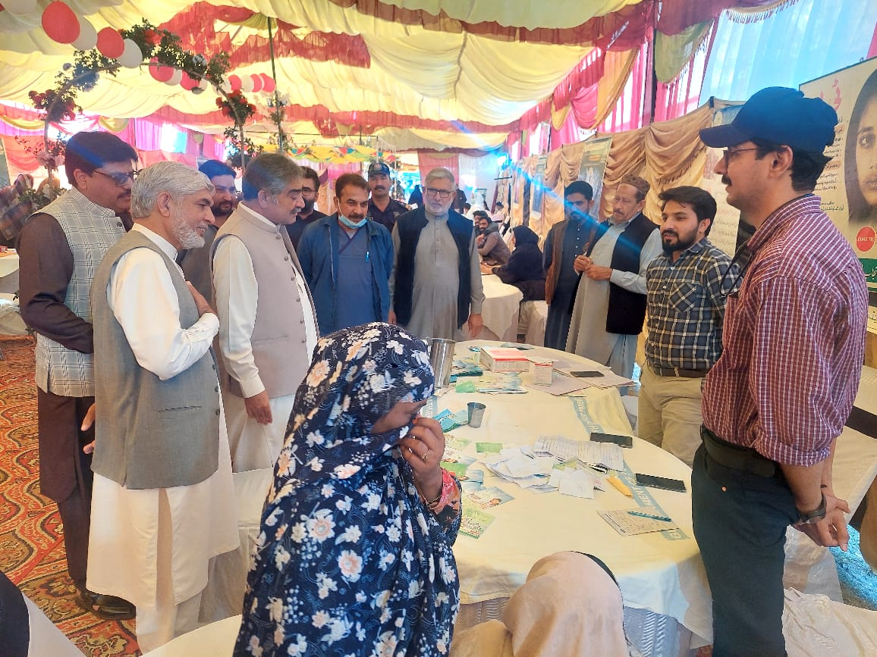
FREE MEDICAL CAMP
Free Medical Camp
Free Medical Camp

Slide 20
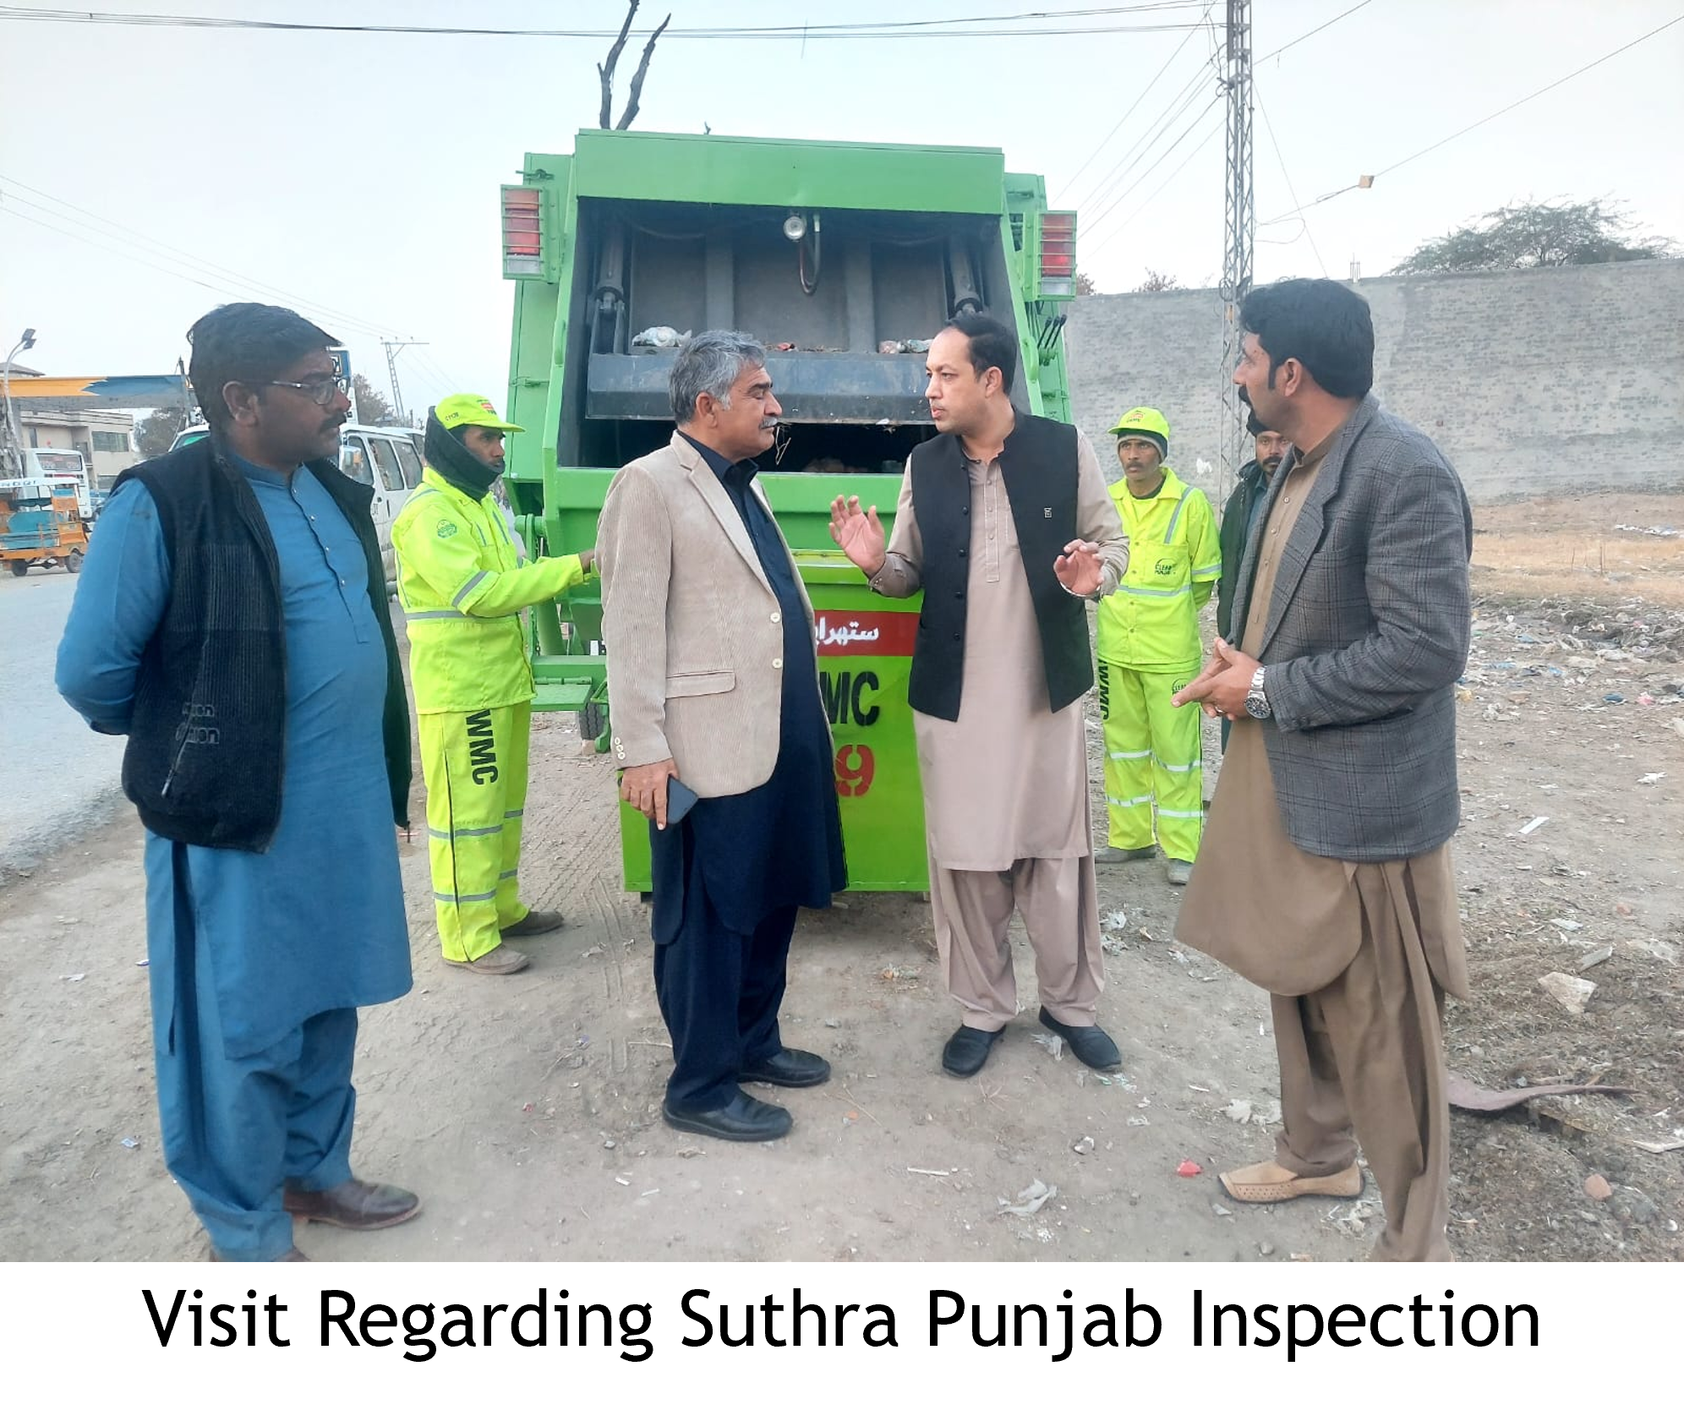
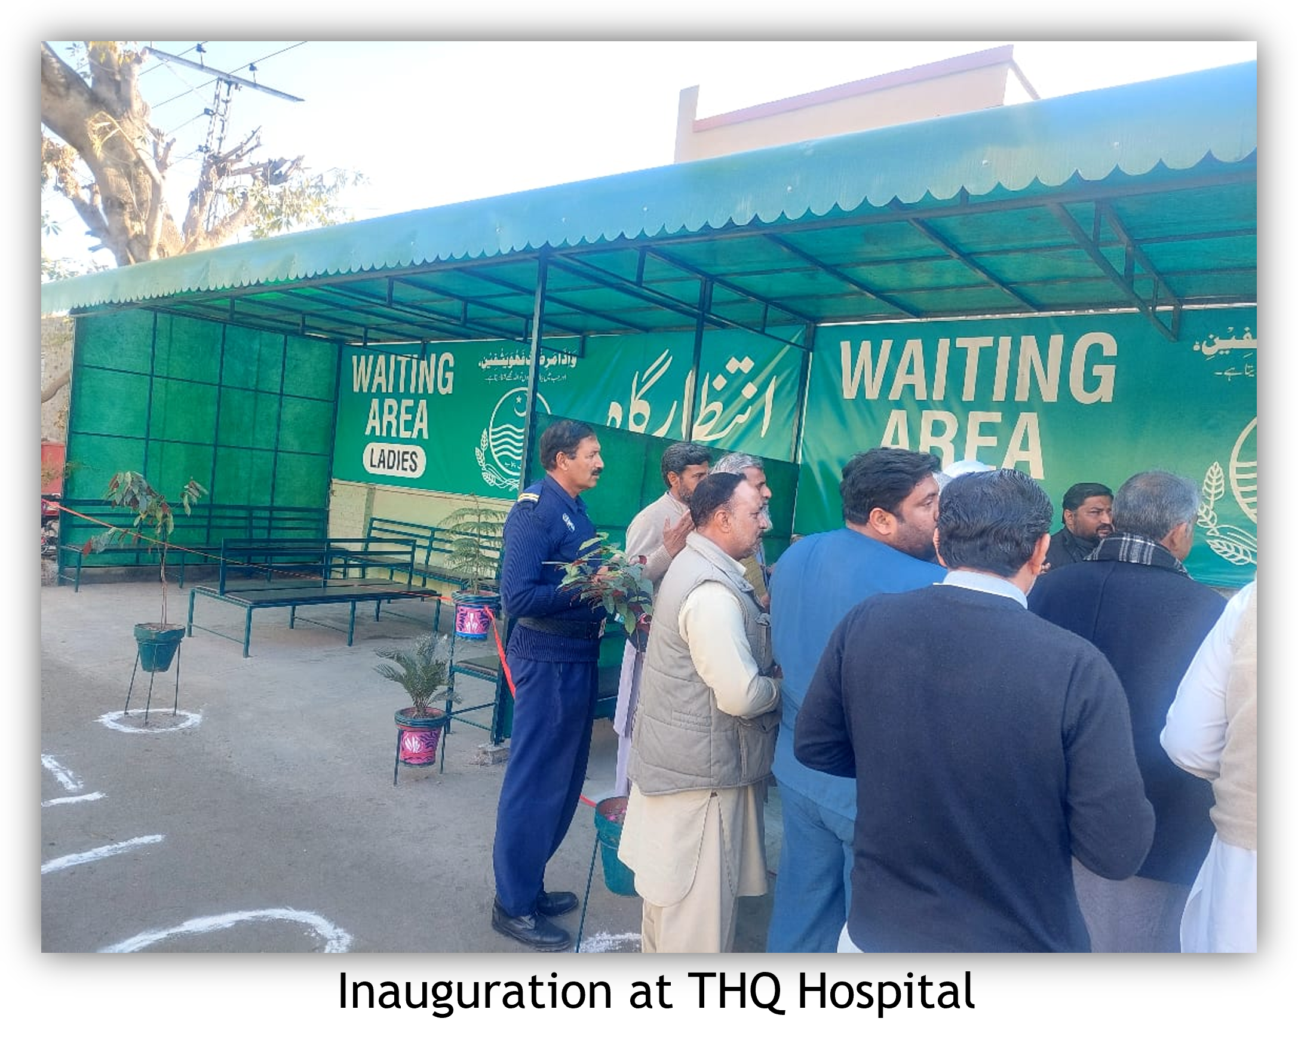
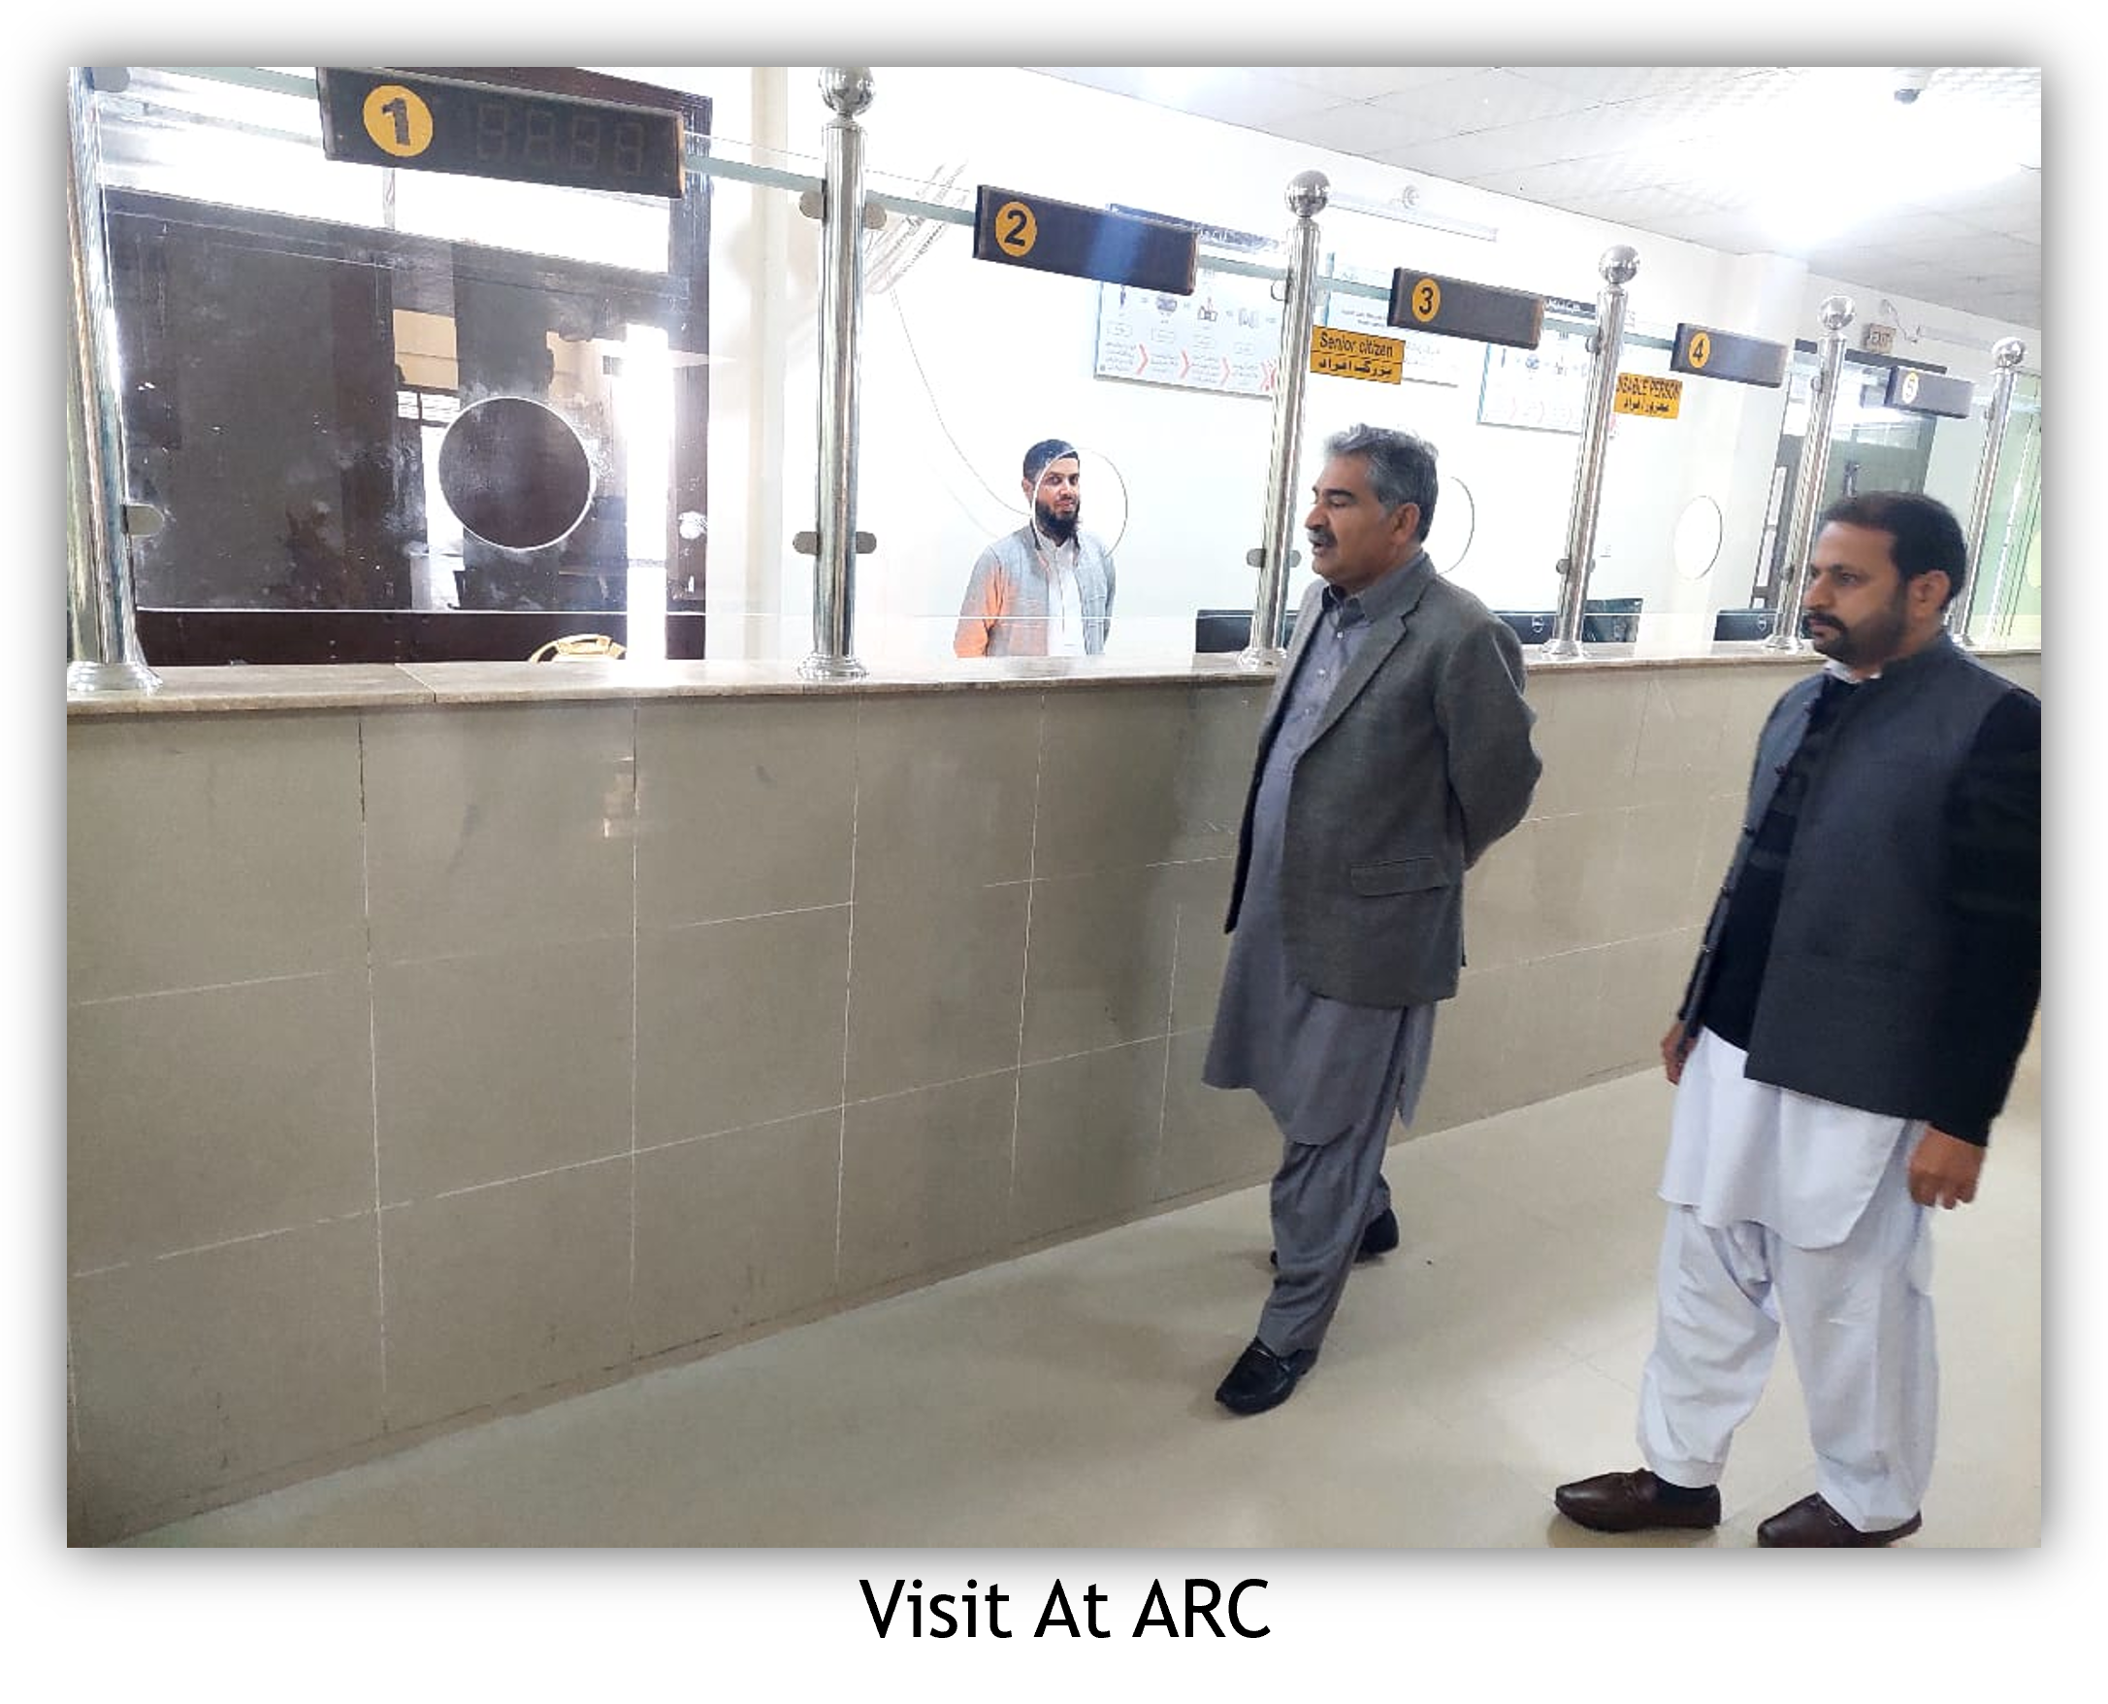
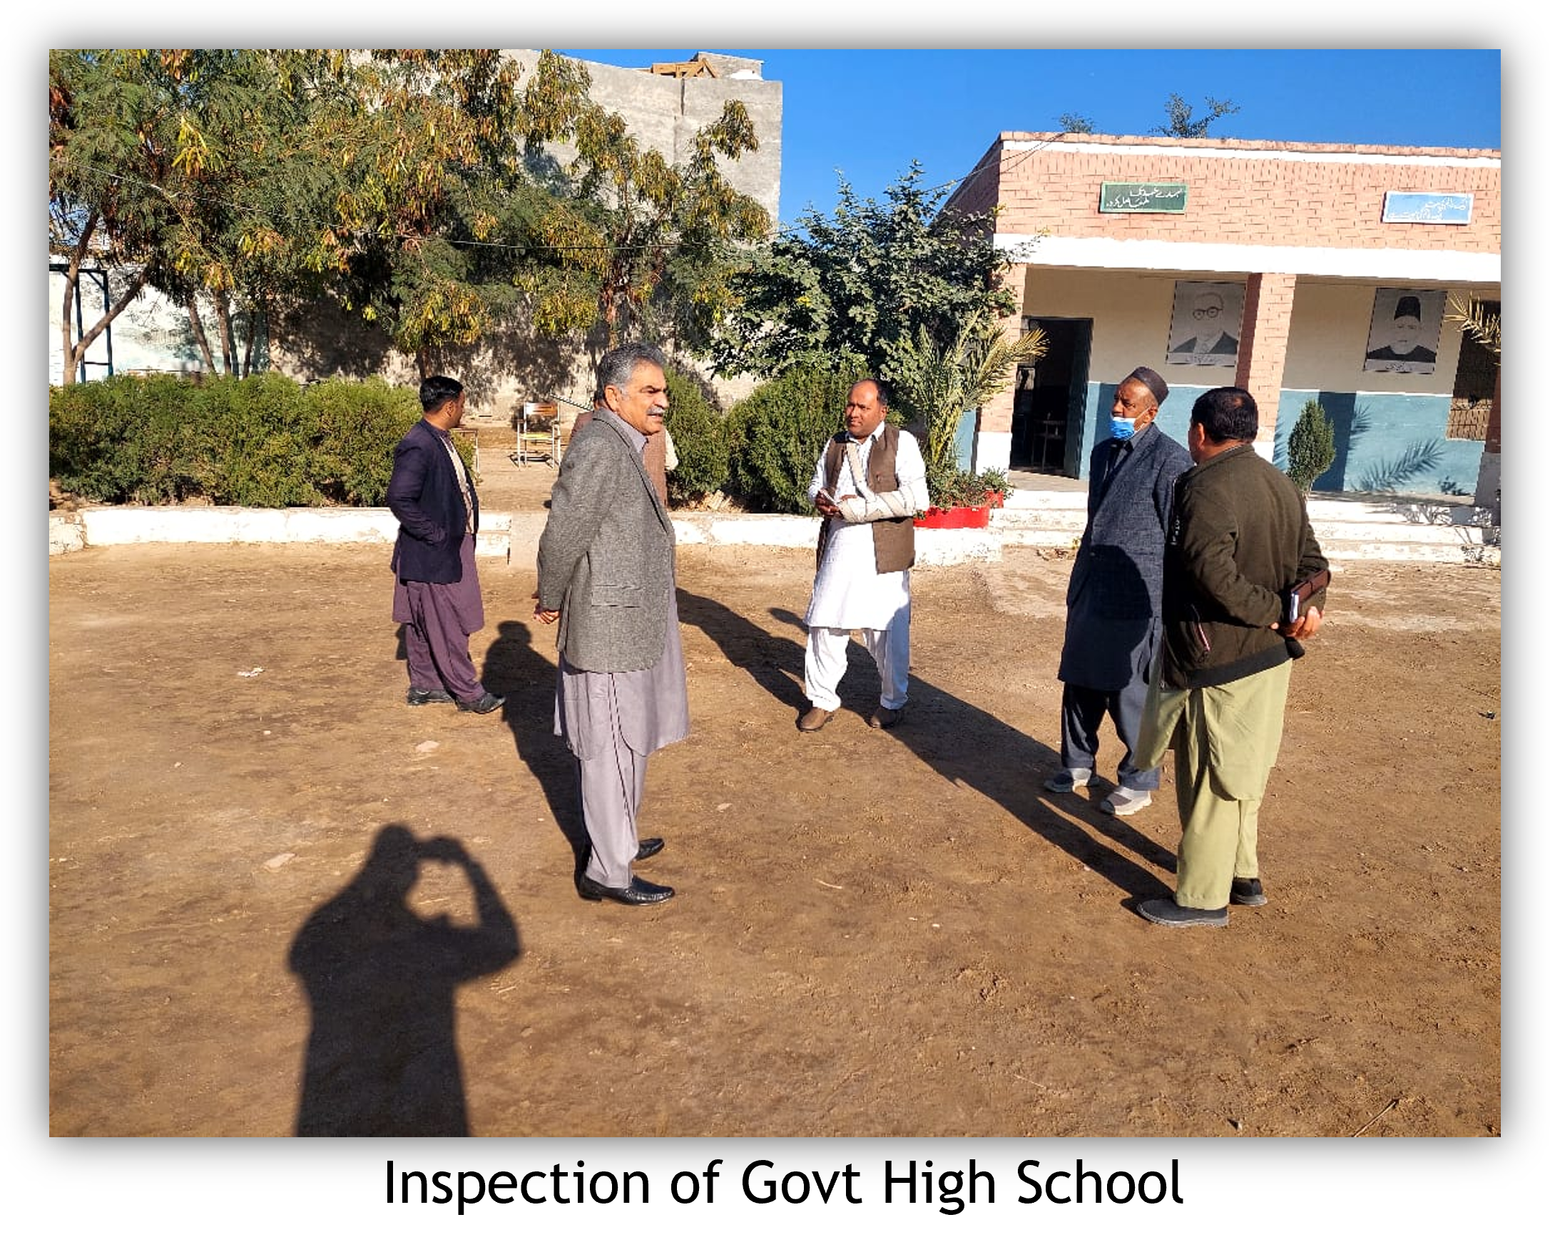
OFFICAL VISIT
V

Slide 21
THANKS

